Slide 1
Voice assistant
LAURA
By SARABJIT SINGH

Slide 2
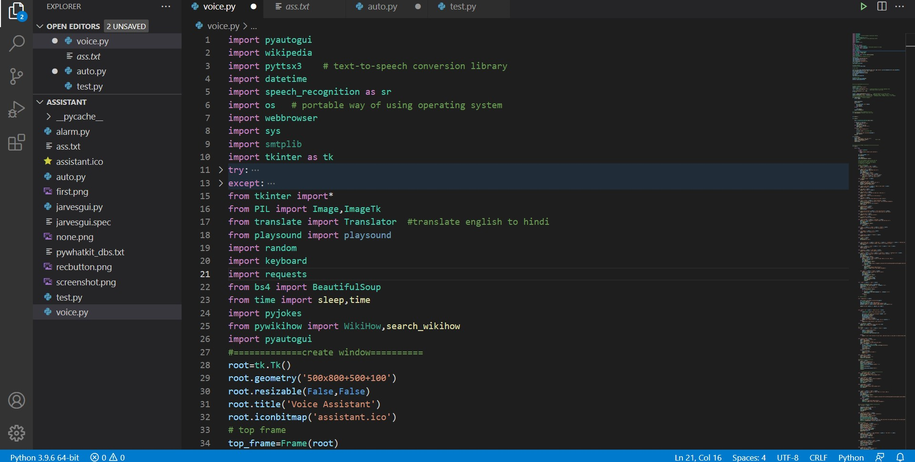
MODULES NEED
THESE PYTHON LIBRARIES I USED IN MY VOICE ASSISTANT.

Slide 3
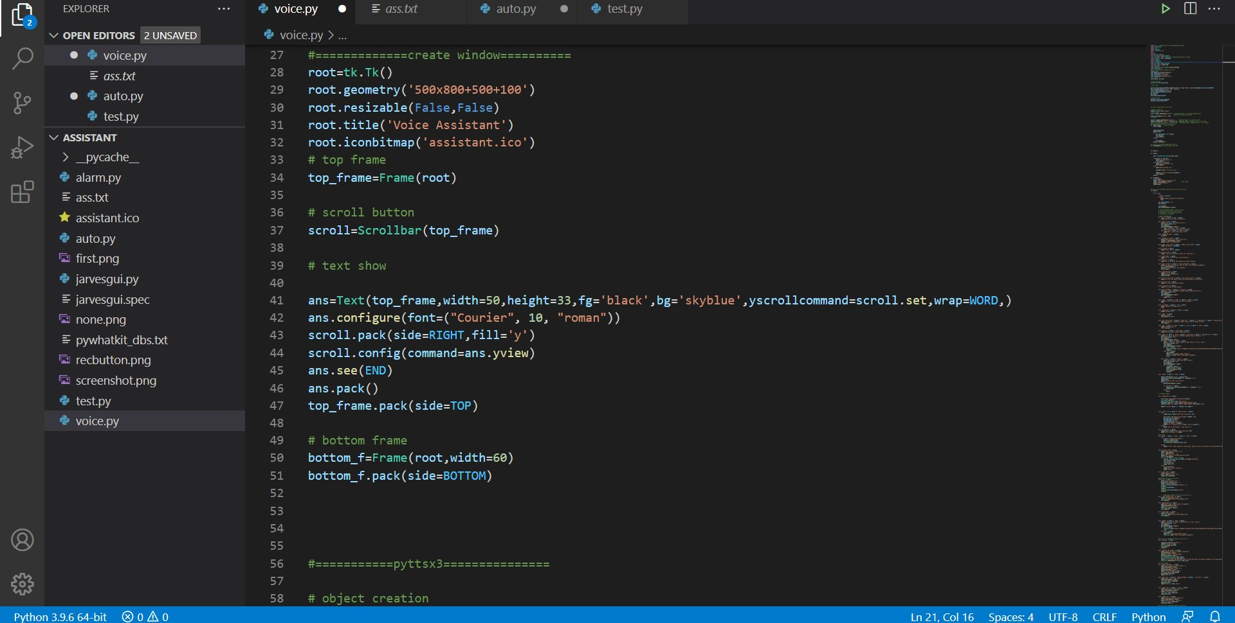
GUI screen of voice assistant

Slide 4
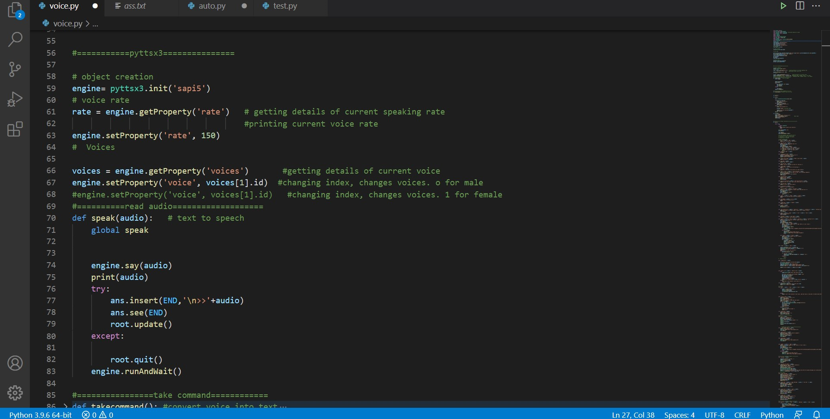
Module pyttsx3 used
Speak function used to convert text to speech

Slide 5
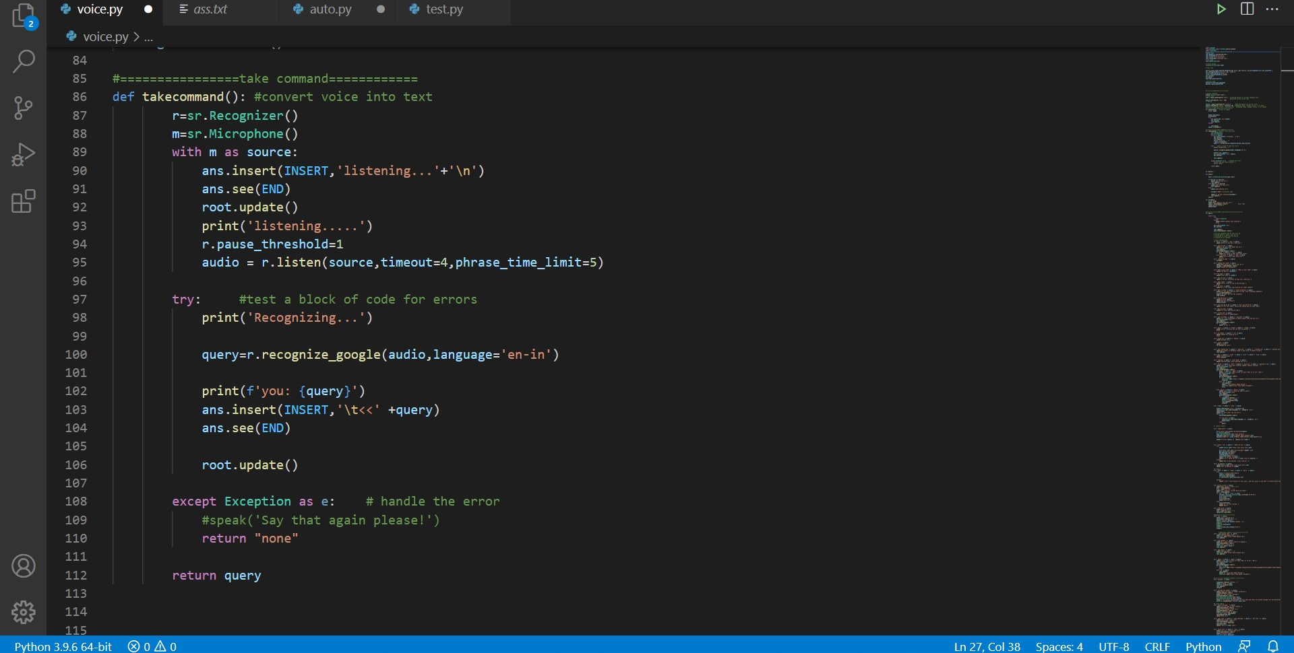
takecommand function
This function convert voice to text
I provide all commands in source code

Slide 6
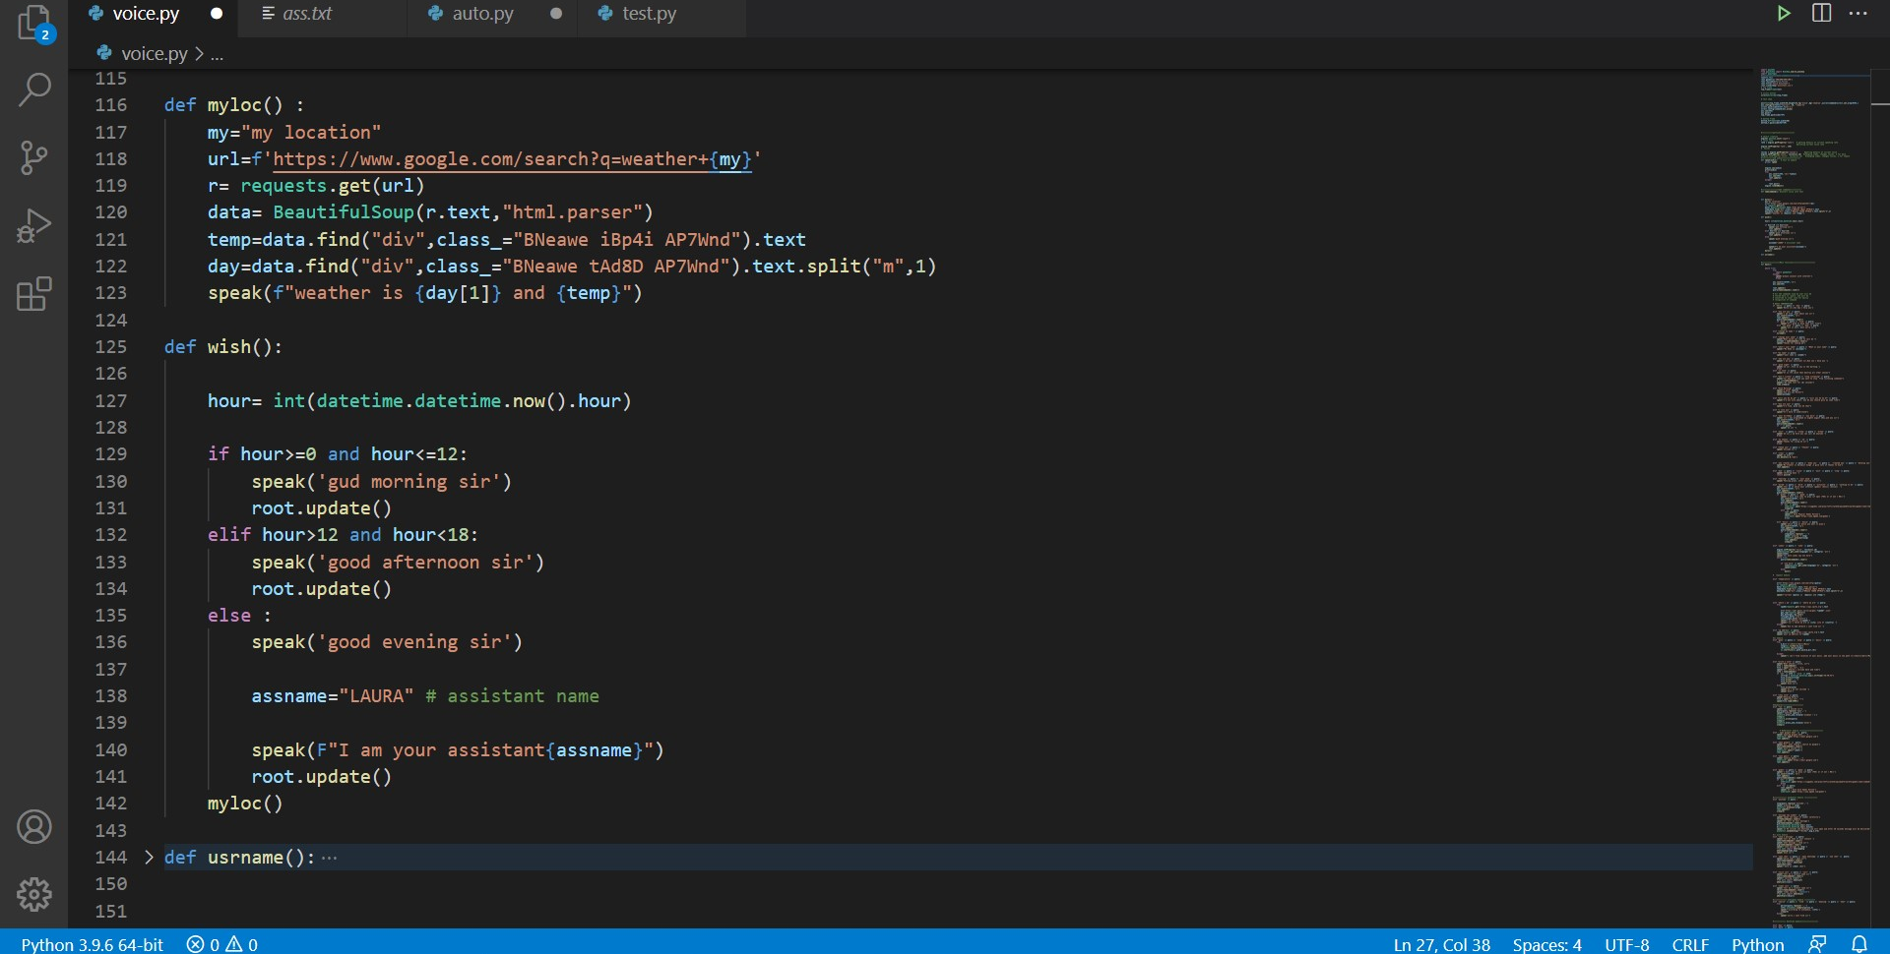
Myloc() function & wish() function
Myloc() give my current location
wish() function used to wish me according to time period

Slide 7
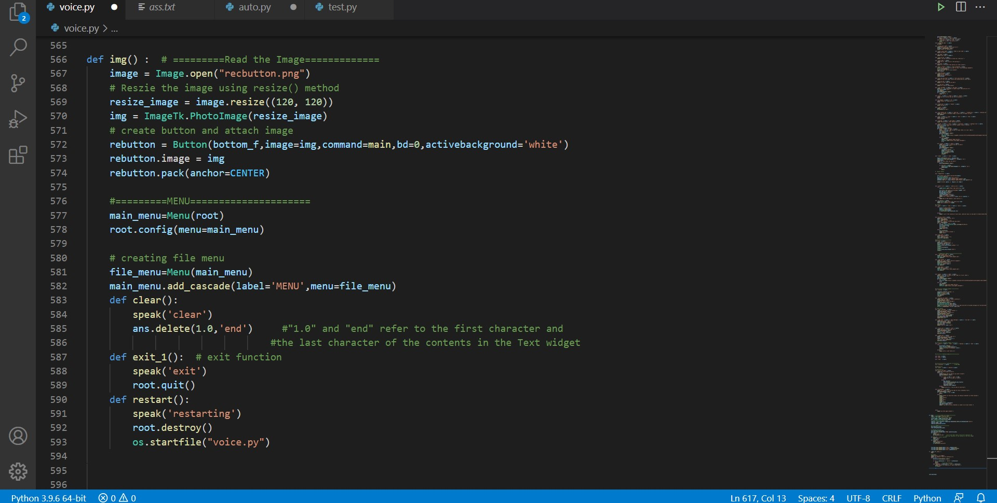
Img() function
In this function have images and menu bar of gui screen
And functions of menu bar

Slide 8
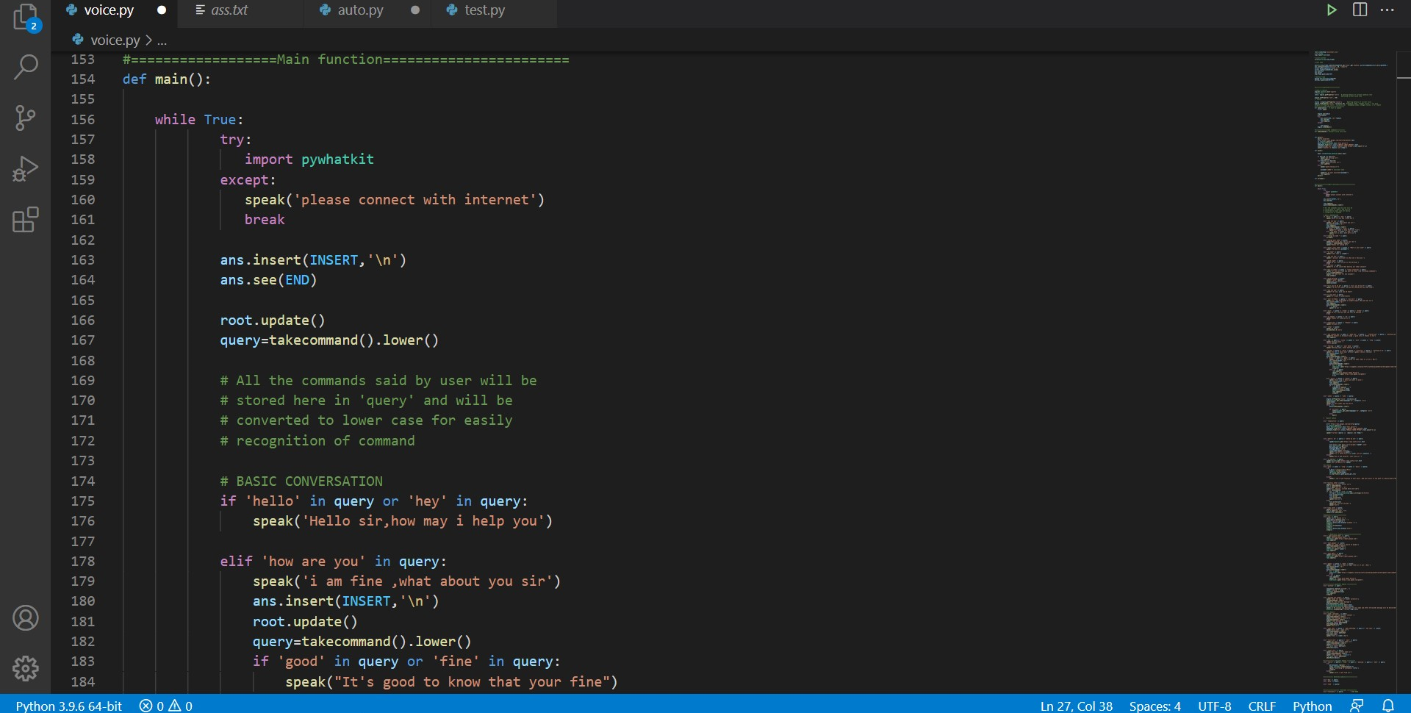
Main () function
In main function all commands executes

Slide 9
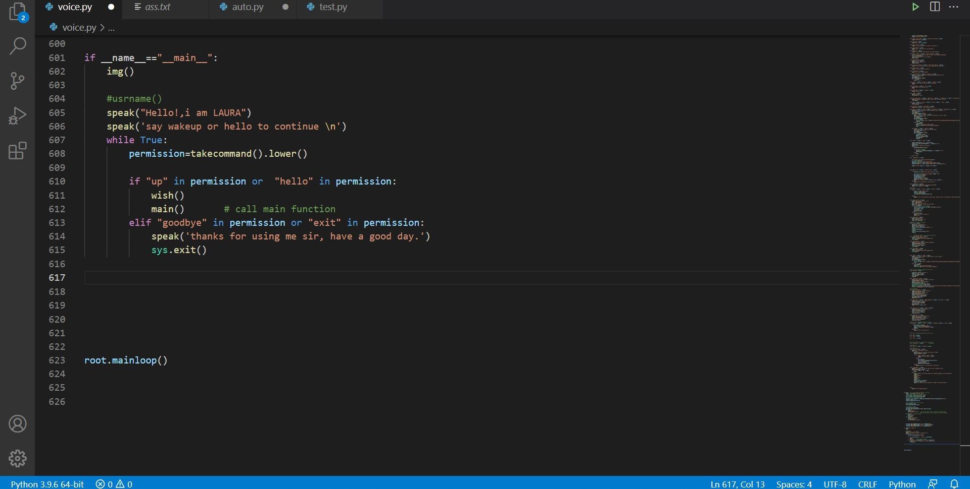
if __name__ == ‘__main__’
if __name__ == ‘__main__’ is used in a Python program to execute the code inside the if statement only when the program is executed directly by the Python interpreter.

Slide 10
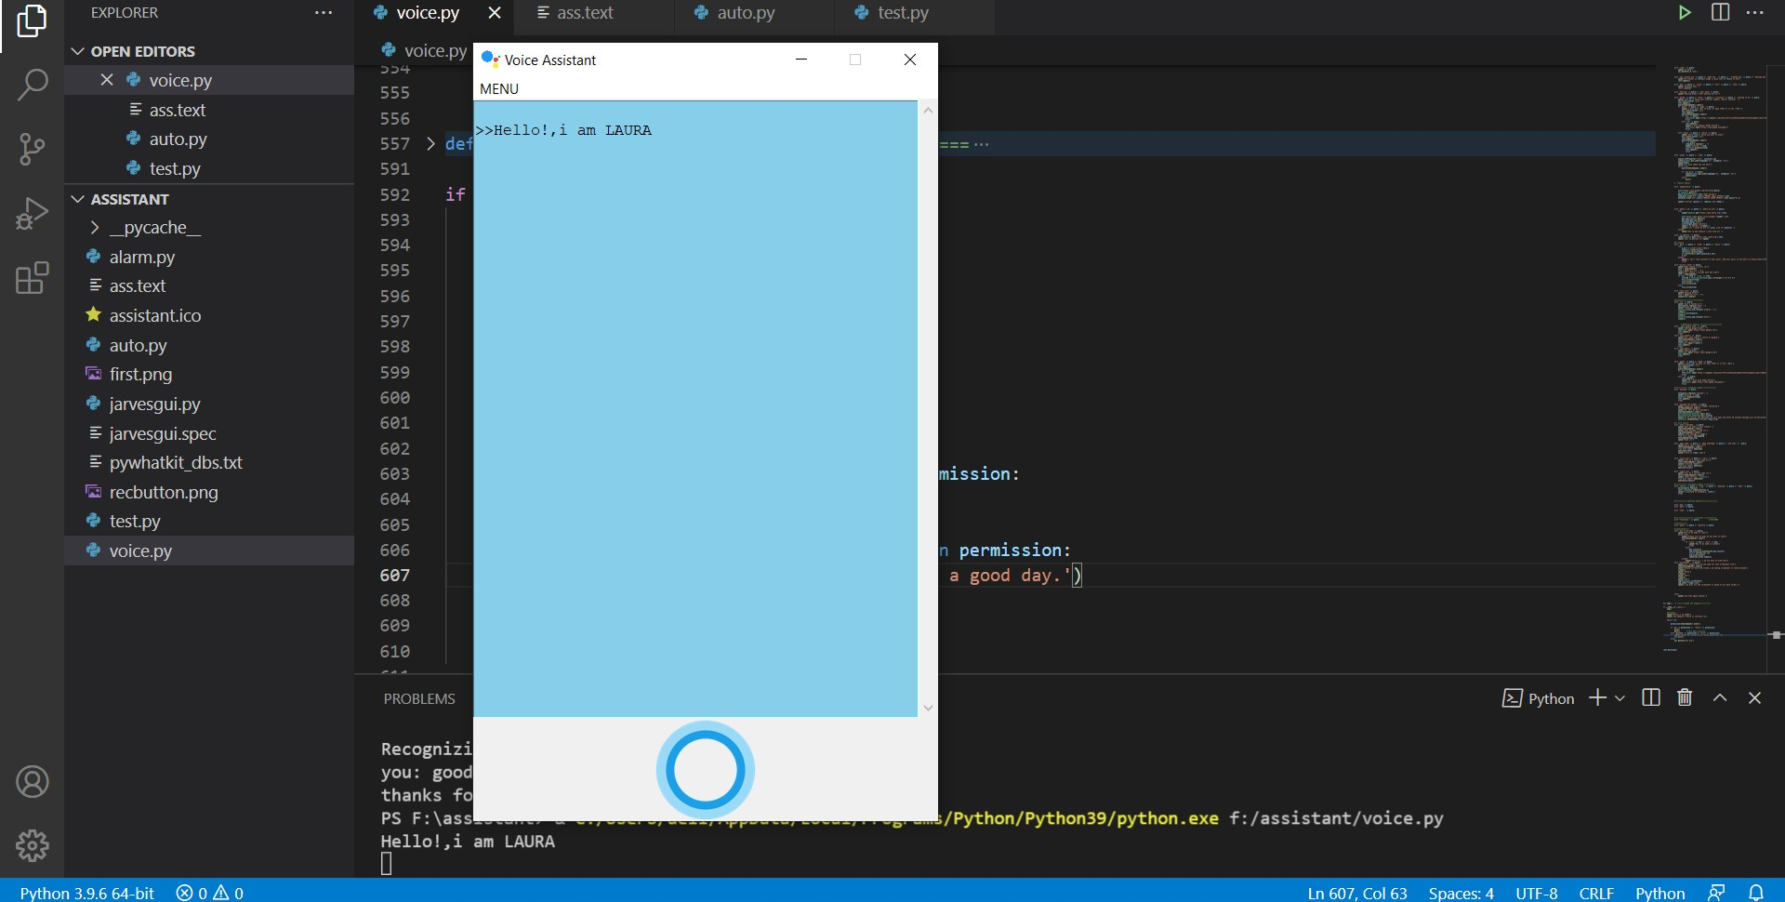
GUI of LAURA

Slide 11
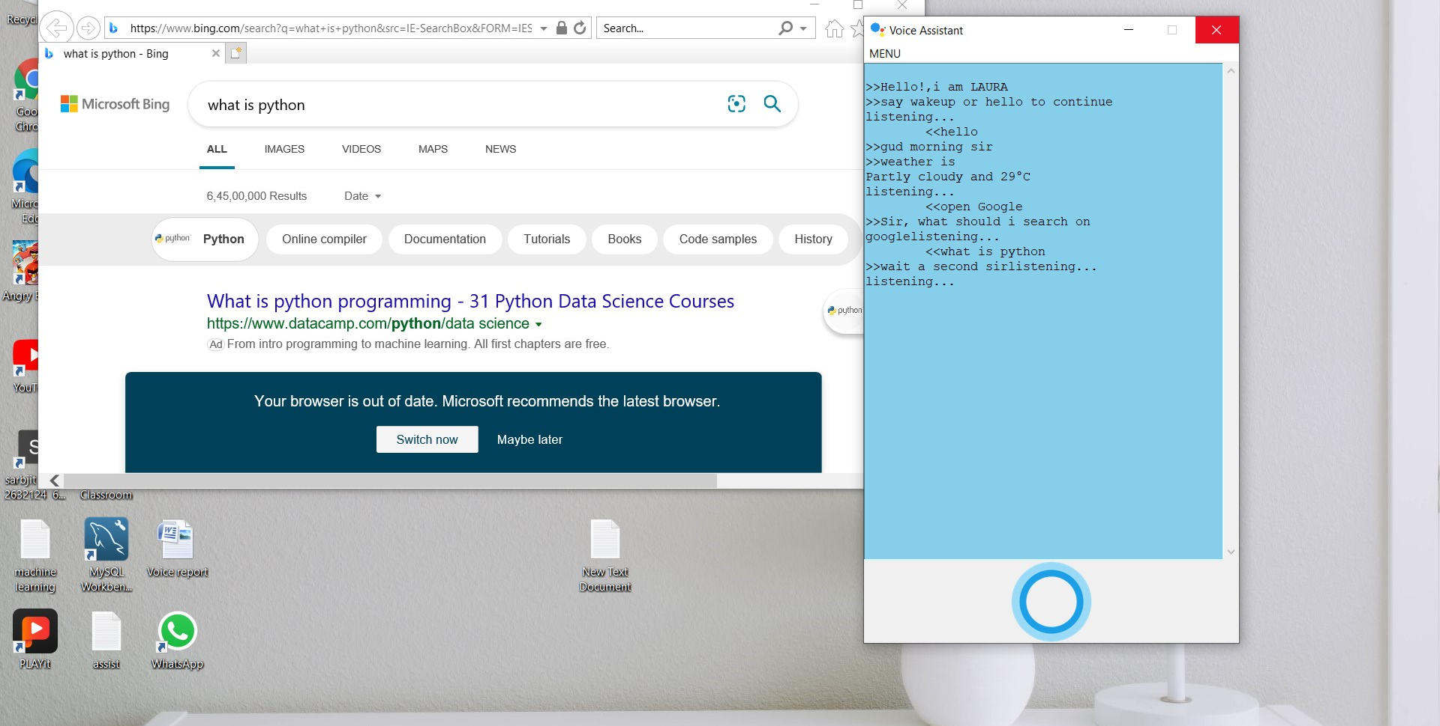
Output for Google search
Say open google
It will ask you what should I search on google

Slide 12
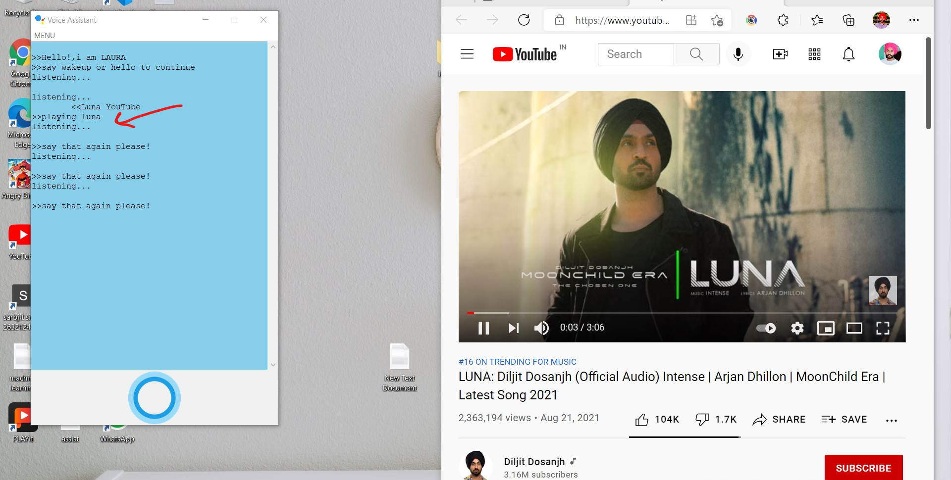
Youtube playing music
Say “music name” on youtube

Slide 13
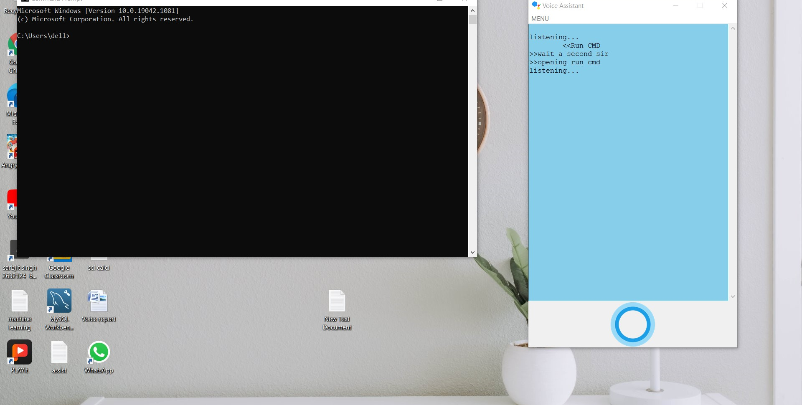
Run cmd
Say run “system files name”

Slide 14
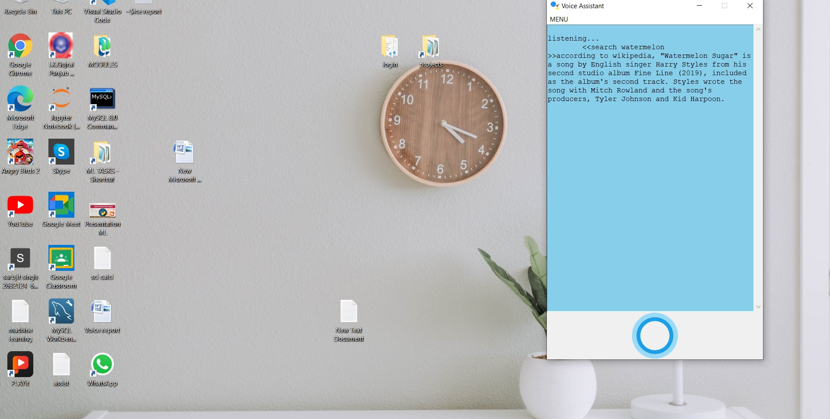
Wikipedia search
Say “search,find,what” anything

Slide 15
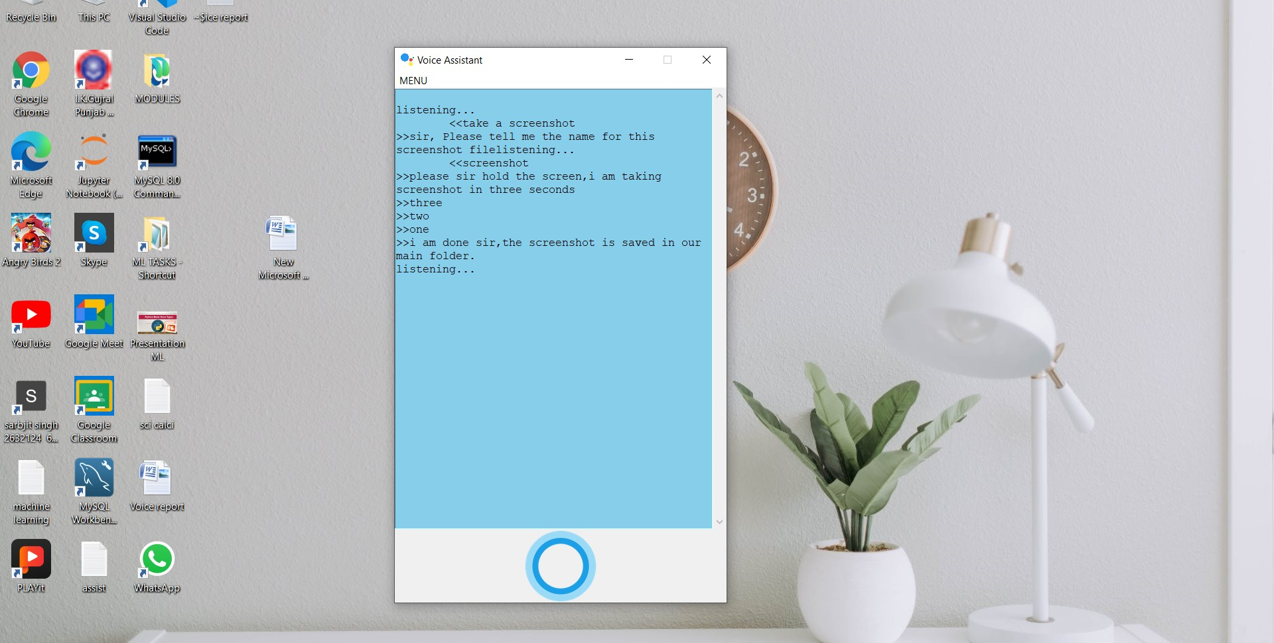
Take screenshot
Just say take a screenshot
After three second done and file save in main folder

